Slide 1
ENSE 374, Milestone 2
Software Group B
Avery, Nic, Renz, Jiahao, Jinkai, Mac
October 11, 2018

Slide 2
Content Review and Analysis
Overall, navigation is alright for the page as a whole
A few dead links
Pages and subpages can be combined into one
Notes:
Mac
Overall, the site contains good content in a mostly easy to navigate way. There is a lot of sidebar content with subpages that make direct navigation difficult but do allow for some discovery with linked materials.
There are several links that are broken or misnamed that will have to be reviewed and updated or fully removed.
Main pages and their subpages could be combined into one page in some cases to make navigation more compact and easy to follow.

Slide 3
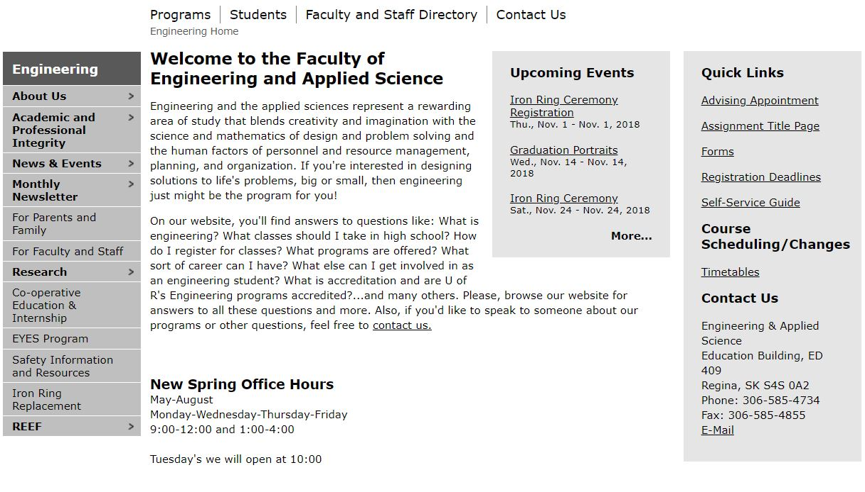
Engineering Home
Navigation Rating:
3-⅘
Sidebar nested content can hide information behind non-intuitive titles
Generally navigation is all in one place making movement through items on the homepage easy.
Stakeholder Rating:
⅘
Very few pages where content is not intended for students
Content Rating:
3-⅘
Usually helpful, occasional dead links which make information gathering difficult
General Suggestions:
Ensuring links are relevant and still active is a large portion of the analysis
Notes:
Avery
Navigation: 4/5
The navigation is easy to use and most of the content is nested in a sidebar on the page. However, because the side bar contains nested content, the content can be sometimes hard to navigate and is cumbersome generally resulting in a neutral rating or 3 or a bit higher at 4.
Stakeholder Rating:⅘
Information is usually applicable to students with a few cases where information needs to be reviewed as it is not immediately applicable to students.
Content 3-⅘ (generally a ⅘)
The content is generally direct and usually helpful, however there are some broken links, repeated links and non-relevant links used that reduces the effectiveness of the content. As well, link names are occasionally vague making it hard to be sure of the content the link will show.

Slide 4
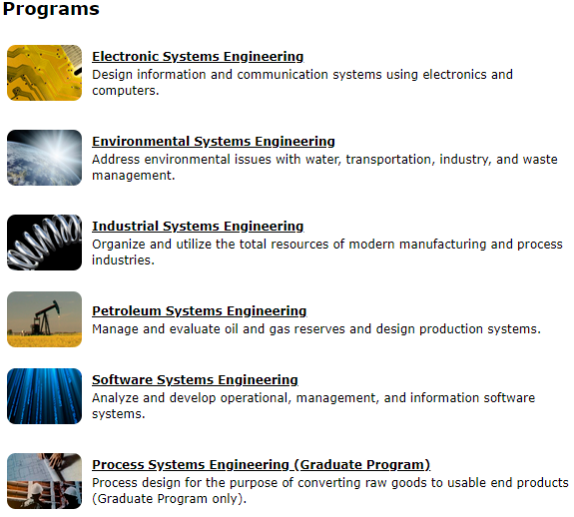
Programs
Navigation rating: 4-5/5
There isn’t a lot to navigate on these pages and it doesn’t have any glaring issues to find the program you need. However the relative short entries for each program and separate subpages add unnecessary clicks if we combine them all
Stakeholder Focus rating: 4/5
The Programs pages contains important information relevant to new students and those considering switching majors.
Content Rating: 3-4/5
The content itself serves its purpose to market the programs to possible students and parents of students
Ideas:
Review page separation, and combine programs due to their relative shortness. We could also adjust “Quick Links” to link to program requirements or admission requirements.
Notes:
Nic
Programs
Navigation is good but not perfect, and could be condensed
The information is relevant to new students and people considering switching majors
Our idea is to combine all the separate program pages into one and adjust the quick links to link to program and admission requirements

Slide 5
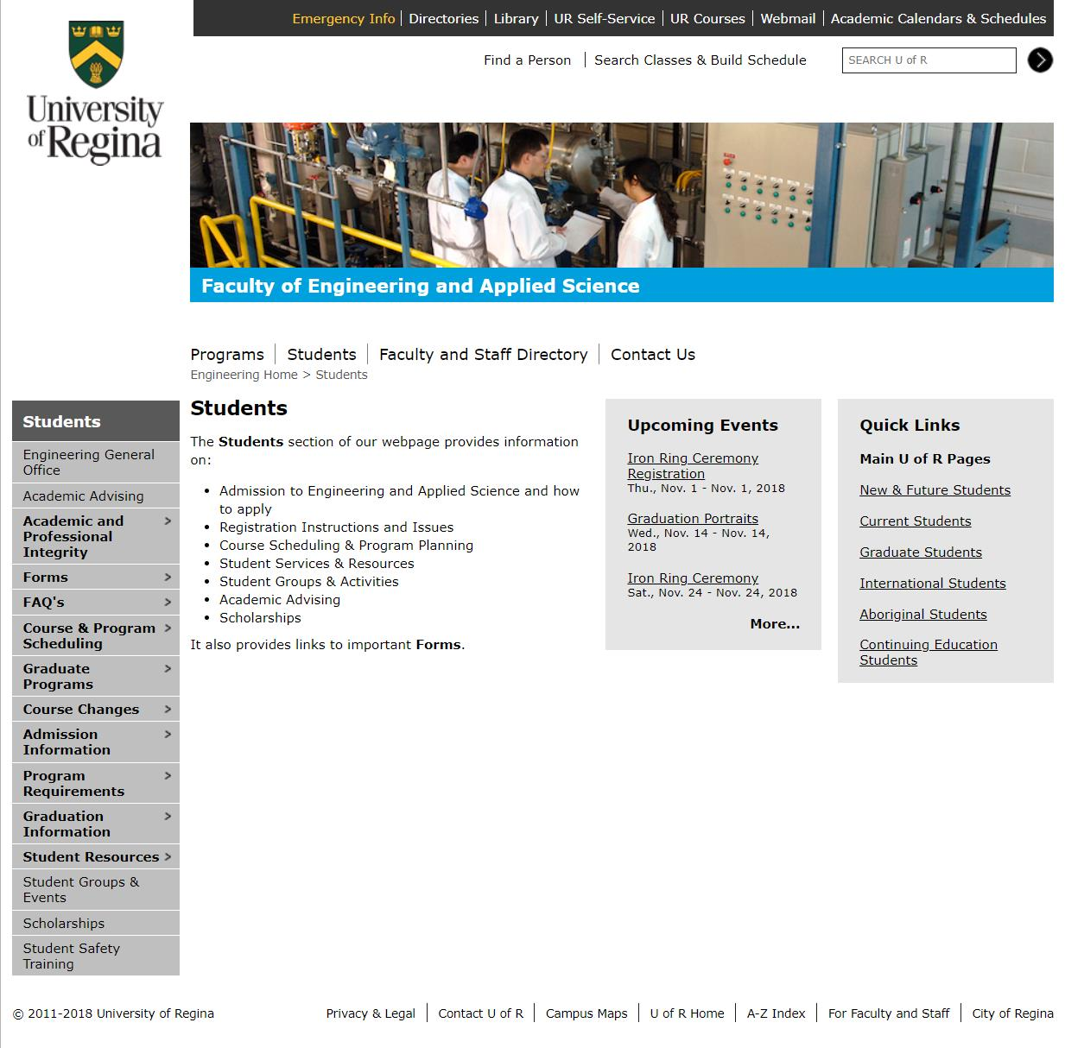
Students
Navigation rating: 1
A lot of information displayed at once
(need to clean up and fold up)
Linked a non-existent page (News & Events)
Stakeholder Focus rating: 4
Remove “ For Faculty and Staff”
Overall looks good
Content Rating: 2
Monthly Newsletter can be placed on other page
Could add more contents just for students such as “What’s new”, “Spotlight”, “Student Services”, “Student Life”, “Social media links”, etc.
Ideas:
The “Upcoming Event” can be made horizontally in order to show more information for student, people can simply scroll up and down to view more.
We can find a more elegant way to organize the page (i.e. future students, current students, alumni, general information) and remove all dead links, or set them up correctly.
Honestly, the overall UofR websites looked so old-fashioned, no designs at all. It is like from 80s and make no changes since then.
Notes:
Jinkai
Students
Navigation
Overall rating: 1
-It’s not that the site is hard to navigate, there is just a lot of information being displayed at once. There are 15 items on the side bar with most items having multiple items within. We’ll want to come up with a plan to clean it up and condense it logically.
Stakeholder Focus
Overall rating:
-There are pages meant for students, pages meant for students and parents and some information faculty/staff.
Notes/Ideas
-We can find a more elegant way to organize the page (i.e. future students, current students, alumni, general information) and remove all dead links, or set them up correctly.
In addition, since this page is for student, more information for students can be added on the page, such as “What’s new”, “Spotlight”, “Student Services”, “Student Life”, etc. It is also nice to have some university official social medias for student to follow up on the page.

Slide 6
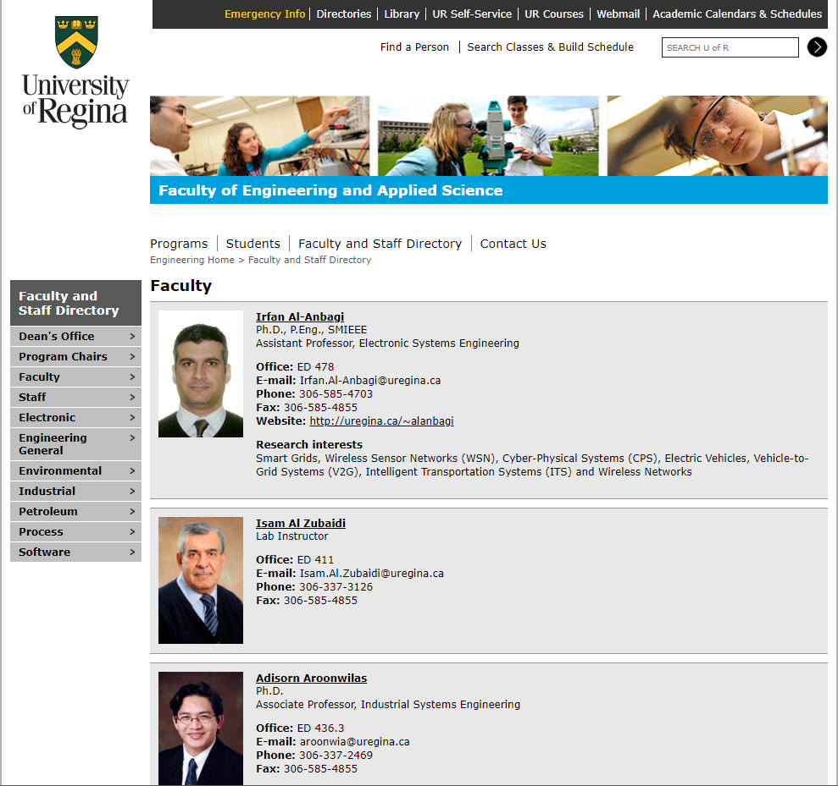
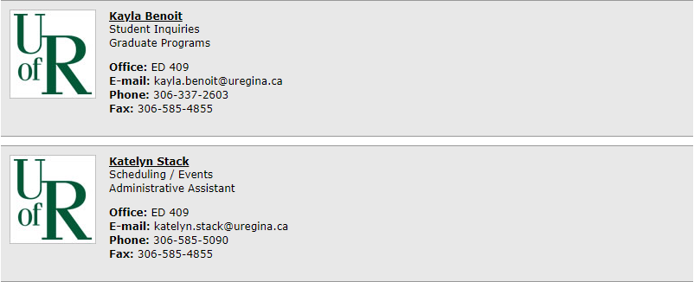
Faculty and Staff Page
Navigation rating: ⅗
Organized alphabetically and are divided into subgroups
Overall content presentation can be time consuming in fulfilling its purpose
Stakeholder Focus rating: 5/5
Definitely keep this public
Relevant for all students, parents, staff, etc
Content Rating: ⅘
Provides just enough information for each individual faculty staff
However, missing pictures of certain staff members does not help the searching process
Ideas:
Add a hierarchy into the existing navigation for the grouped staff members (ie. drop down menus to condense members into a range of last names, level of the courses the professor teaches, etc)
Notes:
Renz
Faculty and Staff Directory
Navigation
Overall Rating: ⅗
Good Points: organized alphabetically and are divided into subgroups on the side navigation
Overall content presentation can be very time consuming - having a user potentially scrolling all the way down the page to find a specific person
Stakeholder Focus
Overall Rating: 5/5
Definitely keep this public
In my opinion, it is relevant for all students, parents, and staff
Although, us students may already have information about a staff member from previous relationships (info of a prof with a class weve taken before), the page could really be useful in the future for referencing (looking for references, asking questions, etc)
Notes/Ideas
Maybe add a hierarchy to the existing navigation system on the left of the page (ie. have dropdowns for say when you click on electronics, it will have a drop down of the last names ranging from A-E, F-J, etc)

Slide 7
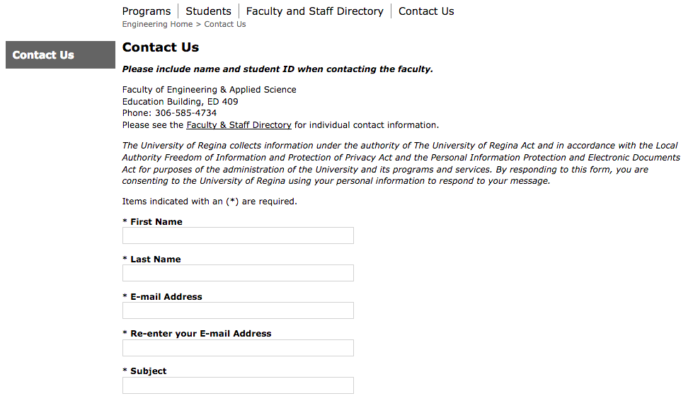
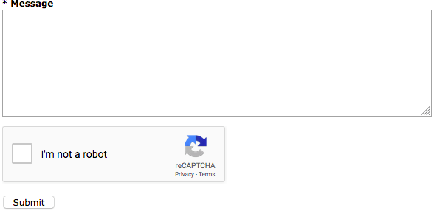
Contact Us
Navigation rating: 5/5 - Simple and clear format - Everything is laid out in one page
Stakeholders focus rating: 5/5 - Keep all relevant info for everyone(public)
Contents rating: ⅘ - The format of inputs is not quite formatting - Add some more fields or sections to perform different functions
Notes/Ideas: - Add validations before submitting the form - Add a section “FAQs”(Frequently Asked Questions) - Add a field that asks if the user is a student or not - Add a message for showing the user is expected to get response in specific time after submitting
Notes:
Jiahao
-navigation:5/5
It is simple and clear format. Everything included.
-stakeholders focus: 5/5
Keep public.
- Contents: ⅘
Not formatting form.
-Notes/Ideas:
It will be great to add a navigation content which is FAQs, providing mostly and frequently questions and answers. The form for Contact Us currently accepts any input and only warns user if there is a blank input field. The form can be submitted if the email is not valid and does not contain an @ sign or .com etc. Maybe have this be more specific so that the user will have information when to ultimately expect a reply.

Slide 8
Removal of Content Proposals
Engineering Home
Programs
Students
Notes:
Mac
The main sections with content issues was the Engineering Homepage and Students. The Contact Us and Faculty and Staff page were relevant and only require a potential reordering of content rather than removal to remain relevant.

Slide 9
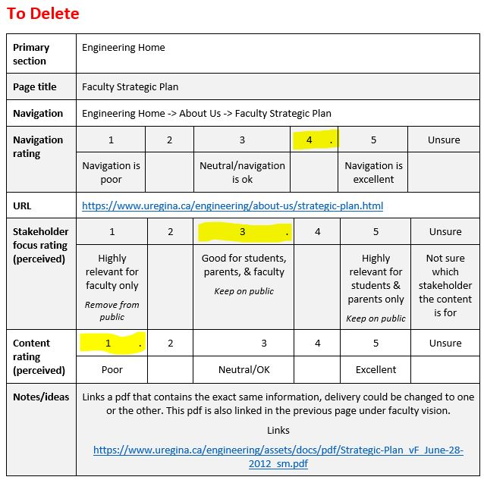
Engineering Home
Faculty Strategy Plan
To remove
This page links to a pdf with the same info, this pdf is also linked under faculty vision and once content and links are reorganized, this page could be removed.
Notes:
Avery
This is a page that contains redundant information and doesn’t have to be moved to the intranet, just removed entirely.

Slide 10
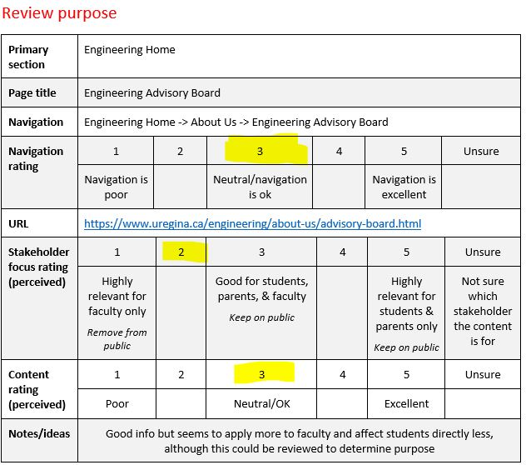
Engineering Home
Engineering Advisory Board:
Unsure, Review and Remove if necessary
The content is not totally relevant to students and could be moved to intranet without many issues but it should be reviewed to understand the purpose.
Notes:
Renz
Content could potentially be moved to the intranet after proper review

Slide 11
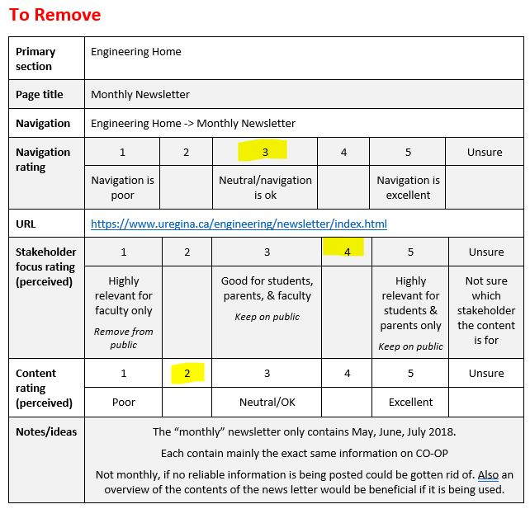
Engineering Home
Monthly Newsletter:
To Remove
Although this content could be useful to students and faculty but it is not regularly updated and information is the same in each and covered in Co-op education in the Students Section. This should not be moved to intranet, simply removed from the site.
Notes:
Jiahao
-Remove part of engineering home.

Slide 12
Engineering Home
Broken Links
News And Events (on the sidebar of homepage)
Information for Parents and Family
Contains 3 broken sub links
Notes:
Renz
There are several broken links to review that we noted in our analysis.
News and Events is supposed to be a separate page, however the link is broken. There is a link to the proper events page in the student section.
Information for Parents and Family is a valid page but links to information that is broken, and in the case of the Iron Ring Ceremony

Slide 13
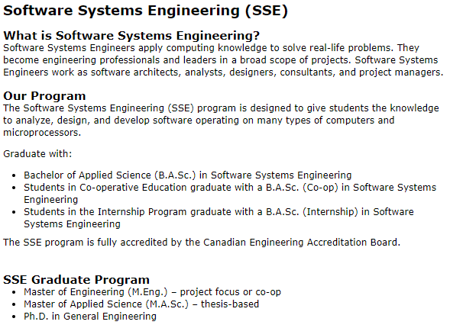
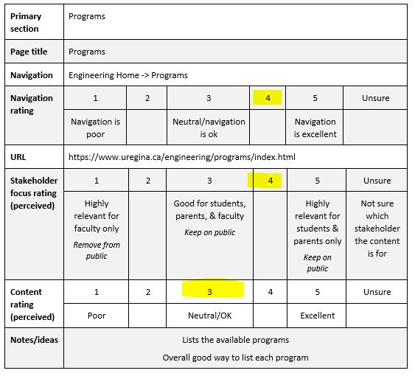
Programs
An example of the amount of information on each program’s page. The subpages are unnecessary as it just takes information away without adding anything
We could easily make the page titled programs and have the breakdown for each included rather than hide all information behind an additional click
Notes:
Nic
From the top picture you can see the relative shortness of each program’s page
Additionally each program page has three subpages (What is the program, our program, and graduate program) that just take information away and don’t add anything
The idea is to make it less clicks to get to the information needed.

Slide 14
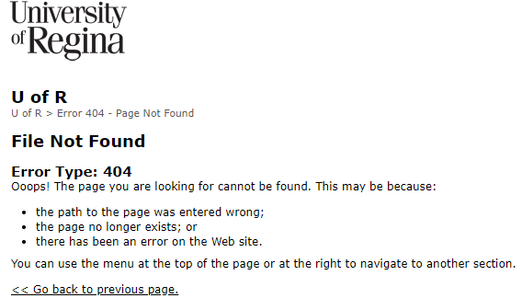
Students Issues
The pages might not be moved to intranet but combining or deleting pages would clean up navigation
One of the biggest issues across the students pages is the amount of times you see this page, Error 404 - Page Not Found (or something similar).
Notes:
Jinkai
The main problem with the Student page, is broken links, there is some content for review but nothing currently noted for intranet purposes

Slide 15
Students
Dead Links:
Link to WHMIS training under Student Safety Training
Many dead links under Graduation Information
Waitlist Page under Student Resources
Reorganization: The subheadings below “Student Resources” can be integrated to “Student Resources” rather than showing individually, it makes navigation redundantly.
Notes:
Nick
Students contains dead links:
Some of them include:
WHIMIS training, on a page meant for safety
Link for application form graduation and convocation information are both broken
The waitlist page works and lists some information, but all 7 links listed for extra info are broken.

Slide 16
Group reflection
•How did you feel about this milestone? What did you like about it? What did you dislike?
The Milestone was a good intro into the analysis and gave ideas of where we wanted to go with the content. The number of pages on the website made it hard to ensure accurate analysis but once it was completed it went well.
•What did you learn about yourself as you collaborated and worked through this milestone?
Six people is a large group, however the extra group members helped us by being able to split up the larger sections and get a second review for each section.
•How will you use what you have learned going forward?
We will use the size of our group to our advantage to get and share more opinions and have the opportunity to work on other group parts when our own task is completed.
•What “stuff & things” related to this milestone would you want help with?
The milestone was pretty straight forward, maybe an example of an analysis of a page but it’s not necessary to complete the milestone well.
Notes:
Jibkai & Mac - share it

Slide 17
Questions?

